Slide 1
Engineering Vocabulary
Jermon Clark
Monday 10.19.15
1st period

Slide 2
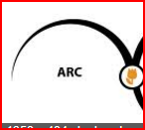
arcs
Arc is a part of the circumference of a circle or other curve.

Slide 3
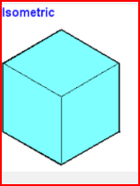
Isometric line
A line (as a contour line) drawn on a map and indicating a true constant value throughout its extent.

Slide 4
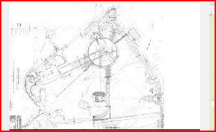
overlay
cover the surface of (a thing) with a coating.

Slide 5
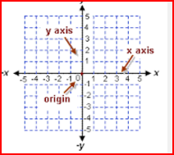
axis
a fixed reference line for the measurement of coordinates.

Slide 6
Isometric sketch
Isometric Projection is a method for visually representing three-dimensional objects in two dimensions in technical and engineering drawings. It is an axonometric projection in which the three coordinate axes appear equally foreshortened and the angles between any two of them are 120 degrees.

Slide 7
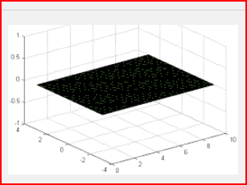
plane
a flat surface on which a straight line joining any two points on it would wholly lie.

Slide 8
Composition
the nature of something's ingredients or constituents; the way in which a whole or mixture is made up.

Slide 9
Point
a dot

Slide 10
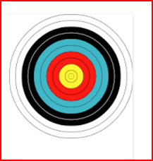
spacedconcentric circles
An archery target, featuring evenly spaced concentric circles that surround a "bullseye". Kepler's cosmological model formed by concentric spheres and regular polyhedra. In geometry, two or more objects are said to be concentric, coaxal, or coaxial when they share the same center or axis.

Slide 11
line
a long, narrow mark or band.

Slide 12
Proportion
a part, share, or number considered in comparative relation to a whole.

Slide 13
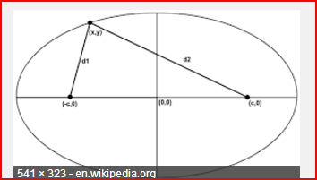
ellipse
a regular oval shape, traced by a point moving in a plane so that the sum of its distances from two other points (the foci) is constant, or resulting when a cone is cut by an oblique plane that does not intersect the base.

Slide 14
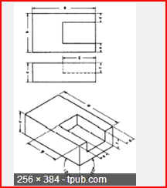
Nonisometric
of, relating to, or characterized by equality of measure; especially : relating to or being a crystallographic system characterized by three equal axes at right angles.

Slide 15
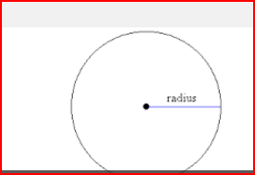
radius
a straight line from the center to the circumference of a circle or sphere

Slide 16
lines
Multiple long, narrow mark or band.

Slide 17
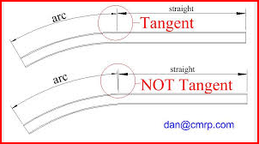
Tangent arcs
the angle, measured in radians, that has a tangent equal to a given number.

Slide 18
guidelines
a general rule, principle, or piece of advice

Slide 19
OBLIQUE DRAWING
Definition of OBLIQUE DRAWING. : a projective drawing of which the frontal lines are given in true proportions and relations and all others at suitable angles other than 90 degrees without regard to the rules of linear perspective.

Slide 20
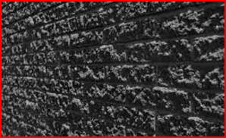
texture
the feel, appearance, or consistency of a surface or a substance.

